Slide 1
Robotic vineyard pruning
Challenges and Opportunities

Slide 2
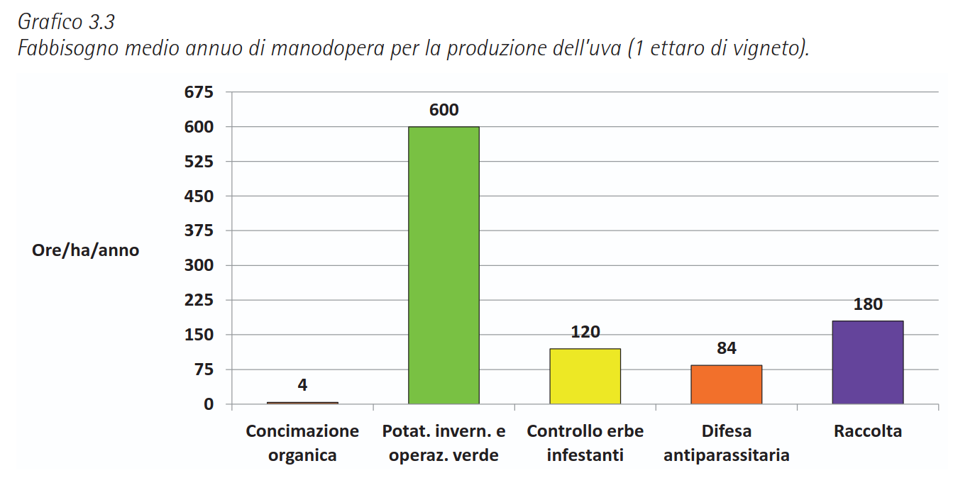
Context & Motivation
Vineyard management is labor-intensive and seasonal
Skilled pruning is critical for yield, vine health, and sustainability
Growing challenges: labor shortages, rising costs, sustainability demands
*Data by Settore di Economia Agraria, Institut Agricole Régional (I.A.R.)

Slide 3
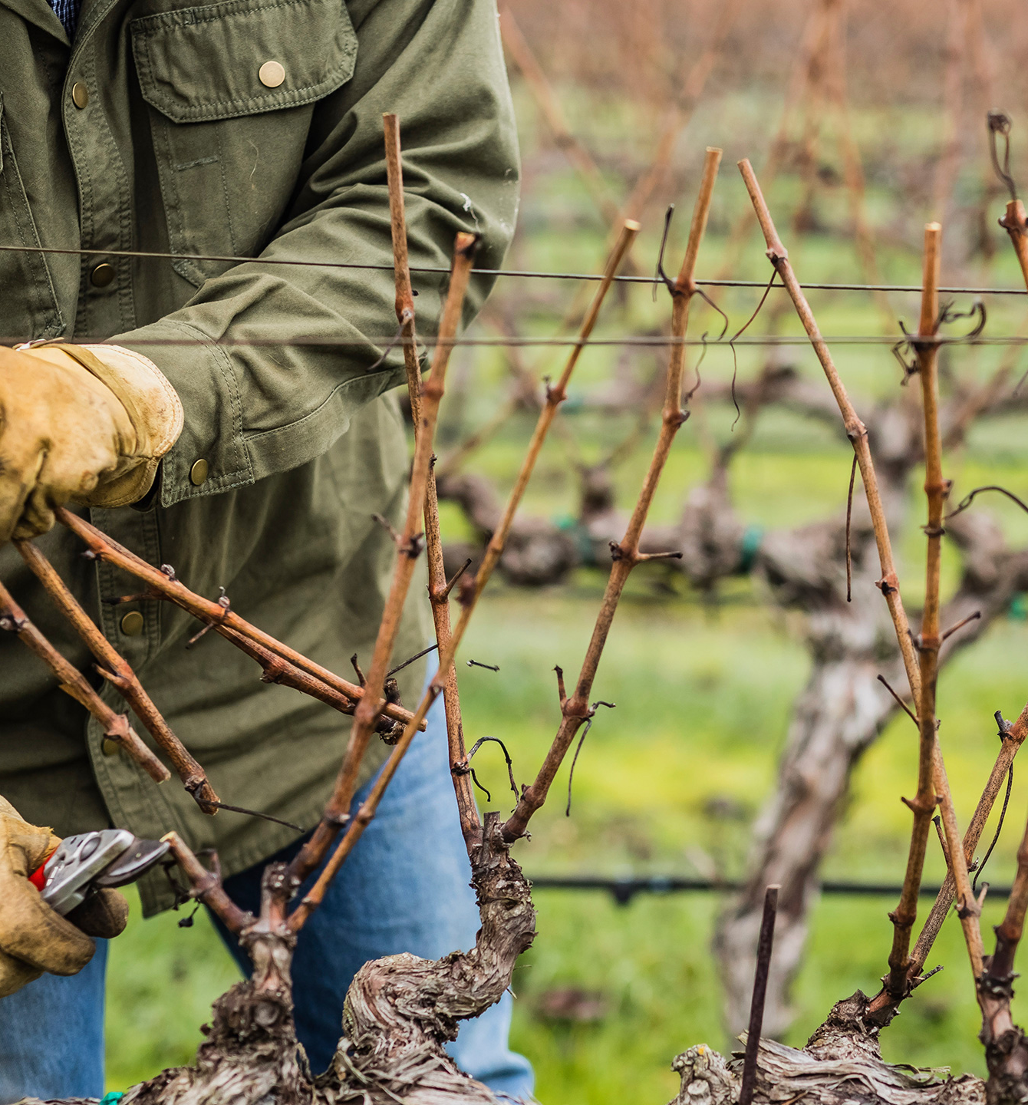
What is Vineyard Pruning?
Annual task: removing canes and shoots to regulate growth
Expert decisions: bud position, cane thickness, vine shape

Slide 4
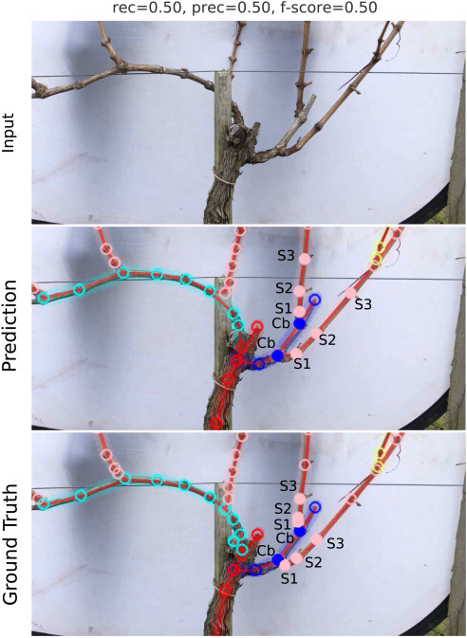
Core Challenges
Perception: identifying canes, buds, branches
Decision-making: mimicking expert pruning strategies
Robotics: maneuvering & safe, precise cutting
Towards smart pruning: ViNet, a deep-learning approach for grapevine structure estimation, Gentilhomme et al.

Slide 5
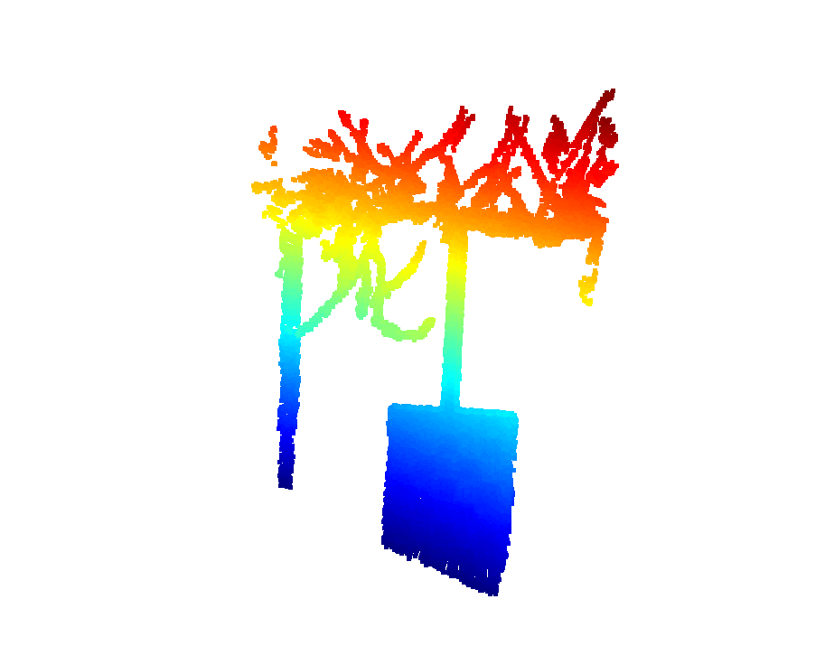
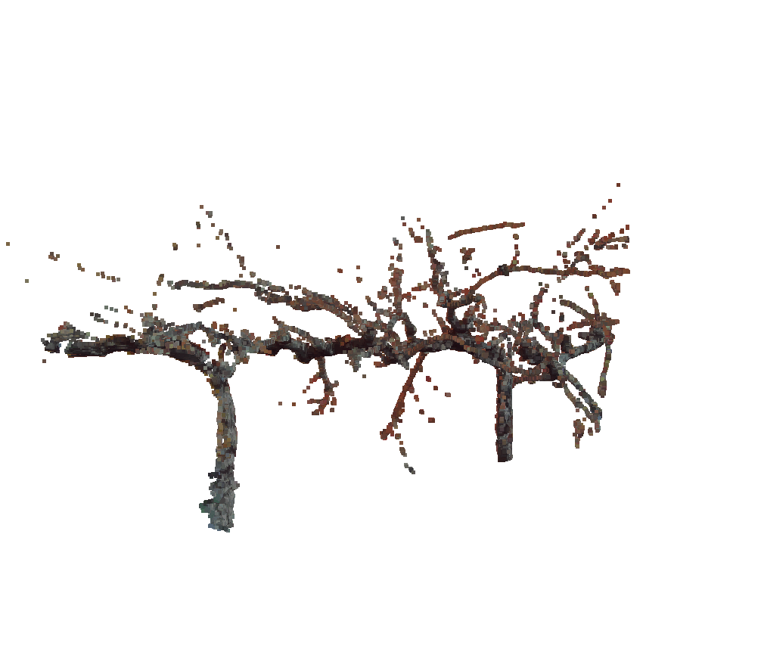
Challenge 1: Perception
Input: images and pointclouds from lidar, stereo camera or other sensors
Output: segmented tree (trunk, single branches)
Key-points:
Choice and positioning of the right sensor
Data filtering
Methodology: classical vs learned (supervised or unsupervised?)
E.g.: AR/VR app for labelization

Slide 6
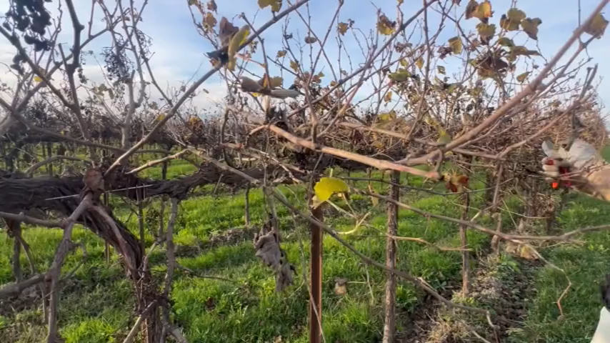
Challenge 2: Decision-Making
Input: segmented pointcloud, images with depth data
Output: list of branches to prune
Key-points:
Encoding geometric and raw data
Algorithmic or learned approach? Or hybrid...

Slide 7
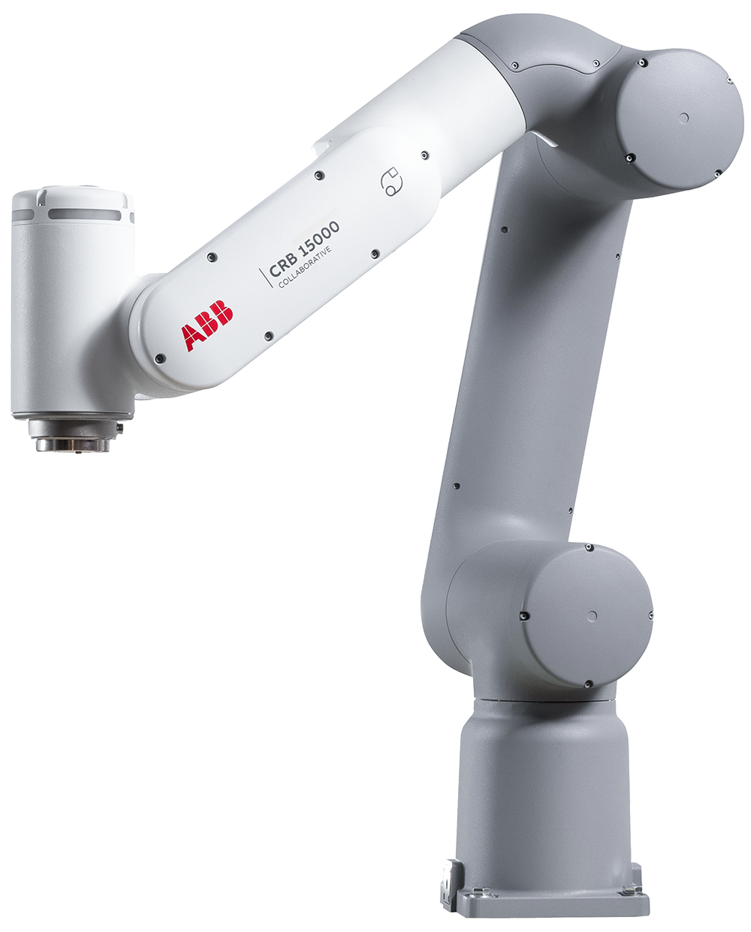
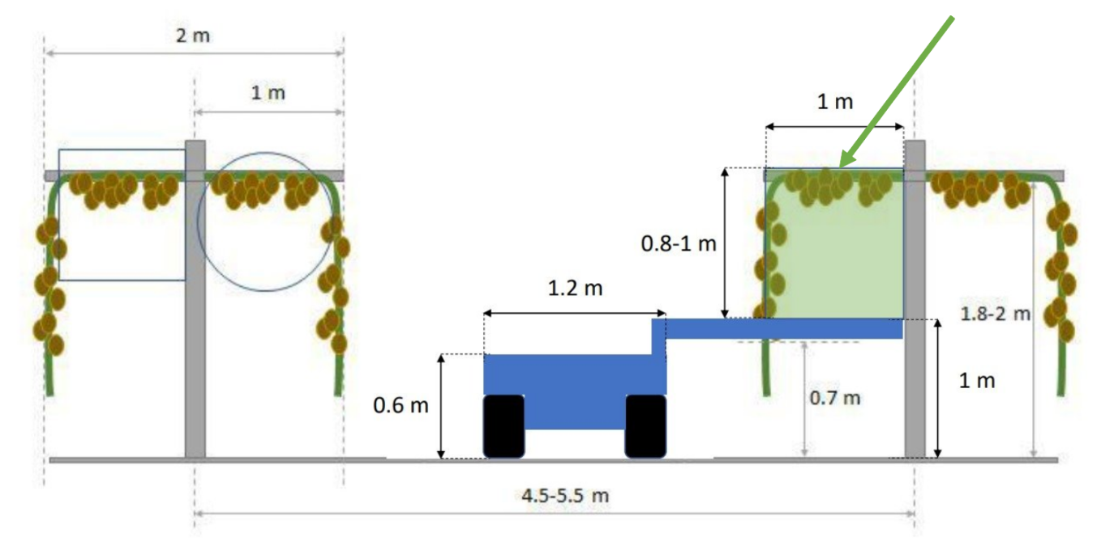
Challenge 3: Robotic layout
Input: geometry of the rover and the vineyard
Output: layout of the robotic manipulator
Key-points:
Simulation of different robotic structures
Custom design vs commercial product
Performance constraints

Slide 8

Questions

